Slide 1
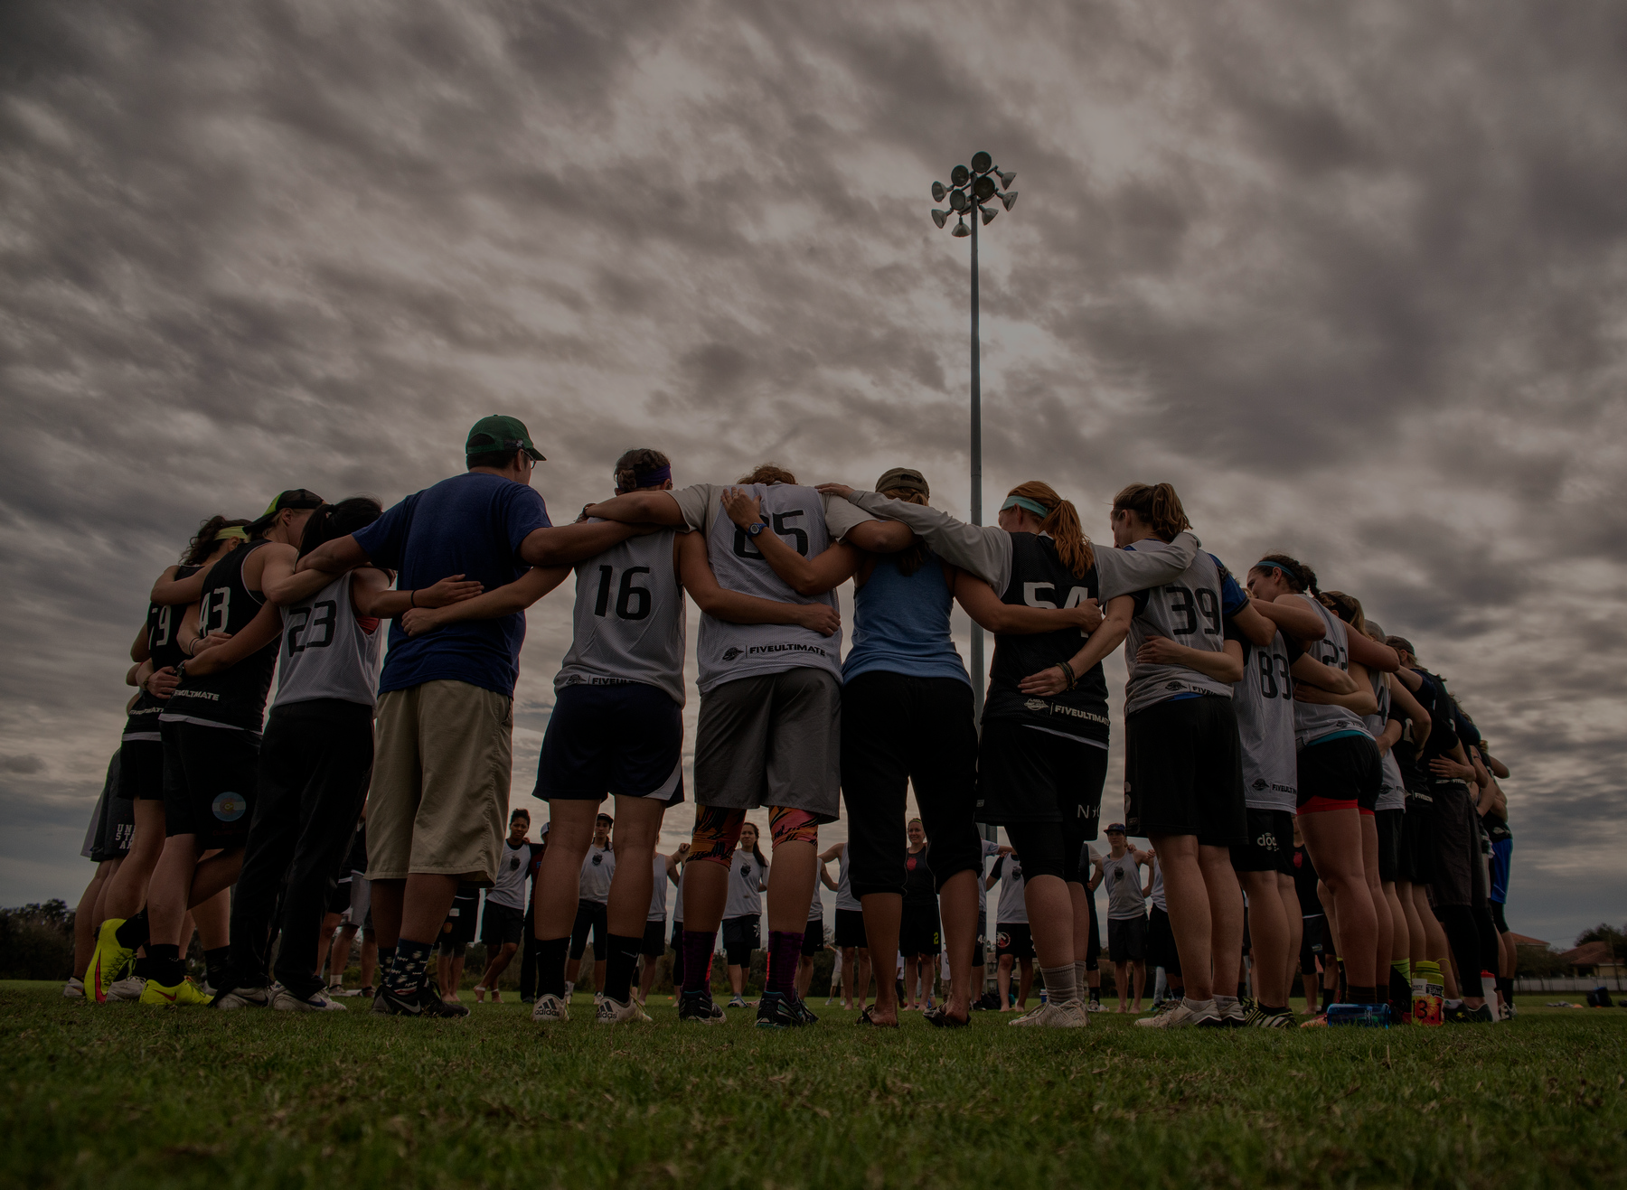
WHO WILL MAKE TEAM USA?
DAT10
OCTAVIA PAYNE

Slide 2
PROBLEM
105
TRYOUTS
35
SPOTS

Slide 3
DATA
DATA:
2020 observations (595 complete)
Excluded mixed players (28)
TRAINING DATA:
Statistical profile of 2013 world games players
9 players
68 observations (21 complete)
Statistical profile of players on fury and riot
97 players
455 observations (126 complete)

Slide 4
HYPOTHESIS
Players who are most consistent and demonstrate greatest sportsmanship have the best chances of making the roster
Both coaches sub evenly (depth vs star-power)
Their teams place heavy emphasis on team conduct

Slide 5
MODELING
METHODS:
KNN
Clustering
Decision Tree

Slide 6
Decision Tree: BPG vs TPG
Groupby(‘Name’).mean()
Year <= 2013
Team != ‘TEAM USA’
2.5

Slide 7
Decision Tree: GPG vs APG
Groupby(‘Name’).mean()
Year <= 2013
Team != ‘TEAM USA’
Notes:
Lowest WG GPG was outlier.

Slide 8
STANDARD DEVIATION OF FEATURES BY WG PLAYERS
 | STD % | PLAYER 1 | PLAYER 2 | PLAYER 3 | PLAYER 4 | PLAYER 5 | PLAYER 6 | PLAYER 7 | PLAYER 8 | PLAYER 9 | AVG
GOAL | 16% | -3% | 41% | 225% | -89% | 225% | 30% | 257% | 54% | 149% | 99%
GPG | 10% | -20% | 20% | 149% | -91% | 188% | 17% | 223% | 38% | 93% | 68%
ASSIST | 45% | 584% | 69% | 44% | 24% | 213% | 424% | 137% | 517% | 182% | 244%
APG | 34% | 418% | 25% | 8% | -1% | 191% | 355% | 114% | 442% | 116% | 186%
BLOCK | 22% | 245% | 130% | 44% | 73% | 149% | 475% | 561% | 130% | 245% | 228%
BPG | 16% | 209% | 121% | 29% | 35% | 119% | 375% | 502% | 110% | 297% | 200%
TURN | 2% | 116% | 23% | -7% | 106% | 17% | 291% | 23% | 243% | 208% | 113%
TPG | 5% | 84% | 9% | -21% | 58% | -2% | 222% | 5% | 200% | 252% | 90%
Every player is significantly more productive on offense and defense than rest of field
Green = significantly better than division avg.
Red = significantly worse than division avg.
Assists and Blocks seem to be where WG13 players stand out the most
All but one player had significantly more turnovers (and in most cases turnovers per game) than the rest of the field
Likely explanation: these players touch the disc more often on their respective teams (no direct statistic to show)

Slide 9
STATISTICAL SPREAD OF BLOCKS AND BLOCKS PER GAME (BPG)

Slide 10
STATISTICAL SPREAD OF ASSISTS AND ASSISTS PER GAME (APG)

Slide 11
STATISTICAL SPREAD OF GOALS AND GOALS PER GAME (BPG)

Slide 12
METHOD: DECISION TREE TUNED BY HAND
Feature | Cutoff*
BPG | 0.325397
APG | 0.412037
GPG | 0.345734
Cutoffs determined by player with lowest mean observation, except for GPG, which excluded an outlier.
Did not place an upper bound on BPG and APG nodes as higher BPG and APG are better.

Slide 13
0.325397
Decision Tree: BPG vs TPG
Groupby(‘Name’).mean()
Year <= 2013
Team != ‘TEAM USA’
2.5

Slide 14
0.345734
Decision Tree: GPG vs APG
Groupby(‘Name’).mean()
Year <= 2013
Team != ‘TEAM USA’
0.412037
Notes:
Lowest WG GPG was outlier.

Slide 15
RESULTS
18 of 24 of women’s roster accurately predicted (75%)
21 of 35 of total accurately predicted (60%)
Sample size: 28 players from mixed division weren’t included in tryouts data
Prediction: 5 players from mixed division weren’t included in prediction

Slide 16
ACCURACY
Accuracy:
(TP +TN) / Total = (21+40) / 77 = 0.792
Error Rate:
(FP + FN) / Total = (6 + 10) / 77 = 0.21
Sensitivity (TPR):
TP / Actual Yes = 21 / 31 = 0.677
Specificity:
TN / Actual No = 40 /46 = 0.869
n=77 | Predicted: Yes | Predicted: No
Actual: Yes | TP: 21 | FN: 10 | 31
Actual: No | FP: 6 | TN: 40 | 46
 | 27 | 50 | n=77
Sample size: 28 players from mixed division weren’t included in data scrape
Prediction: 5 players from mixed division weren’t included in data scrape
Notes:
High specificity makes sense because there are clear tiers of players. Moderate to low sensitivity could be due to different roles players have on team (defensive player, handler, cutter, etc.) that would affect certain stats one way and others another.

Slide 17
HURDLES/TAKEAWAYS
Poor stats (quantity, type, and consistency)
Need stats at every tournament
Add yards gained, conceded, touches, hockey assist, points played
Difficult to include mixed players in automated fashion (4 WUGC players from mixed)
Name changes
FURY and RIOT not significantly different from other teams
Spirit scores did not impact

Slide 18

THANK YOU!
DAT10
OCTAVIA PAYNE

